Slide 1
RdB Integrity Constraints

Slide 2
Define business rules in the design phase

Slide 3
Constraints: Protect against incorrect or invalid INSERT and DELETE statements
Example: attempt to insert a user name that already exists
DDL keyword: UNIQUE

Slide 4
Integrity Constraints
Null
Represents value for an attribute that is currently unknown or not applicable for tuple (e.g. survey)
Deals with incomplete or exceptional data.
Represents the absence of a value and is not the same as zero or spaces, which are values.
Name | UID | FB_ID | SSN | GPA | Degree | Grad_Yr
John Smith | 110718 | 882459 | 12345 | 3.7894 | IS | 2024
XXX | 110999 | NULL | NULL | 3.8000 | IS | 2024

Slide 5
Integrity Constraints
Name | UID | FB_ID | SSN | GPA (?) | Degree | Grad_Yr
John Smith | 110718 | 882459 | 12345 | 3.7894 | IS | 2024
Entity Integrity
In a base relation, no attribute of a primary key can be null.
(Don’t forget another constraint) PK can uniquely identify a tuple
Referential Integrity
If foreign key exists in a relation, either foreign key value must
match a candidate key value of some tuple in its home relation or
foreign key value must be wholly null.
(Example in next slide)
General Constraints
Additional rules specified by users or database administrators that define or constrain some aspect of the enterprise.(e.g. staff in a branch<20)

Slide 6
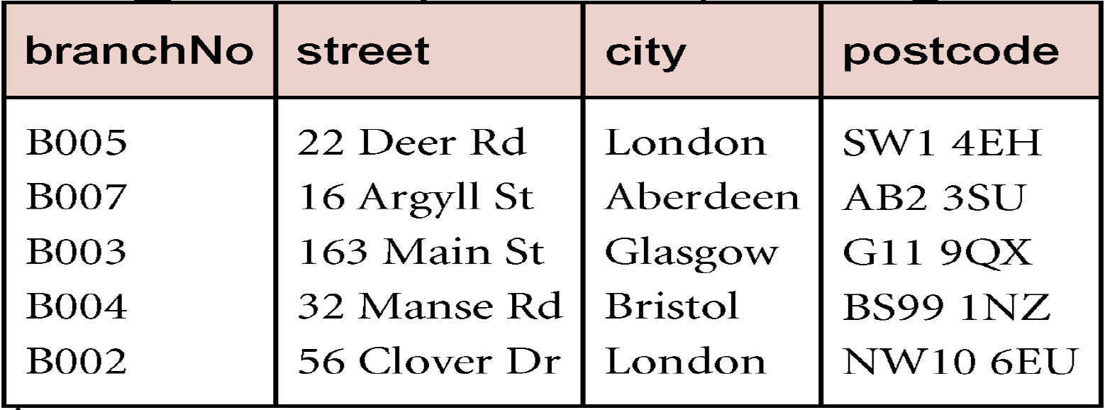
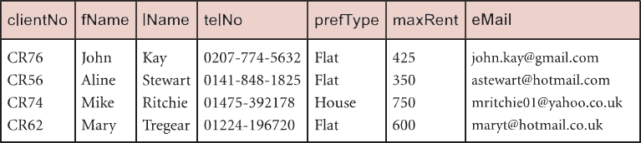
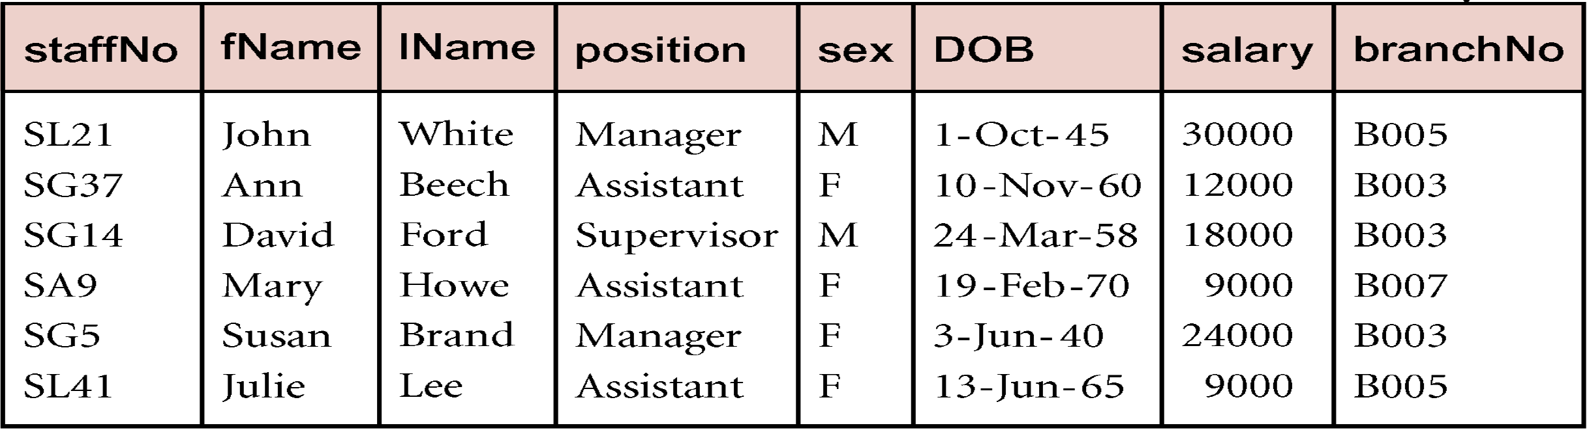
Practical Analysis of Constraints and Business Rules for Relational Data
2 Step Check!
null foreign key
referential integrity
entity integrity
unique

Slide 7
Can’t delete a parent key value that has a foreign dependency

Slide 8
Referential Integrity in Delete/Update action (see next slide for example first)
ON DELETE NO ACTION (default) -- (Cannot delete)
Prevents a tuple p in Table (with the PK) from being deleted when a tuple f in some other table (with the FK) points to tuple p.
ON DELETE CASCADE (Fire)
When a tuple p in a table (with the PK) is deleted then all tuples f in other tables (with the FKs) that refer to p are also deleted.
ON DELETE SET NULL (Allow uncertainty)
When a tuple p in a table (with the PK) is deleted then all tuples f in other tables (with the FKs) that refer to p are set to null.
NOTE:
The tuple f (with the FK) can be deleted at any time without checking referential integrity of tuple p (with the PK)!
Notes:
Explain in connection with the previous company schema example (also in next slide)

Slide 9
“ON DELETE”, what do you want to do?
SET NULL?
NO ACTION?
CASCADE?

Slide 10
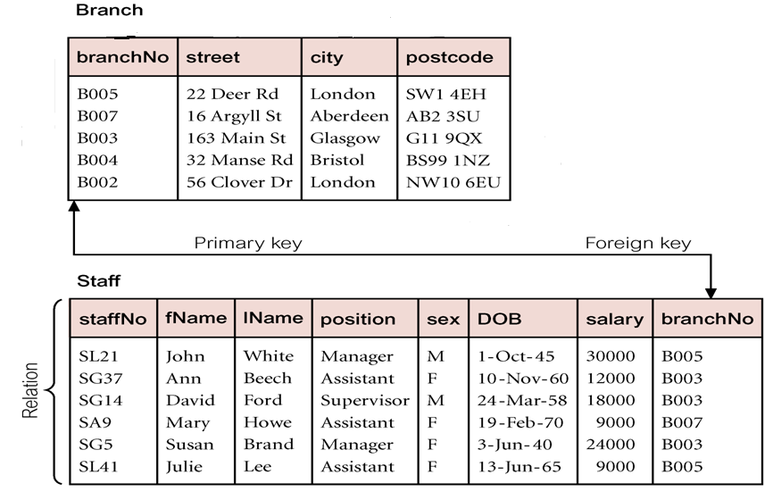
Specifying FK is not enough! (It regulates insertion of new data in Staff; change in home relation?)
Need New Referential Integrity!
What would happen to staff in B003 if the branch is closed ? (delete a row in Branch)
Fire all of staff (CASCADE)
Cannot close branch before new allocation (NO ACTION)
Allow Uncertainty (SET NULL)

Slide 11
Specify FK is not enough! (ON UPDATE CASCADE/NO ACTION/SET NULL)
Need New Referential Integrity!
What would happen to staff in B003 if the branch is renamed? (update B003 to B001)
Update branch # for all of staff (CASCADE)
Cannot update branchno e.g. bcard (NO ACTION)
Allow Uncertainty (SET NULL)

Slide 12
Referential Action -- Protect FK from changes in PK in home relation
It’s a property on FK in the Foreign Relation!! (FK is affected)
Referential Action is about How FK is affected, when there is change in PK – go to see rules

